Slide 1

Sales Dashboard Overview
Summary of Key Sales Metrics

Slide 2
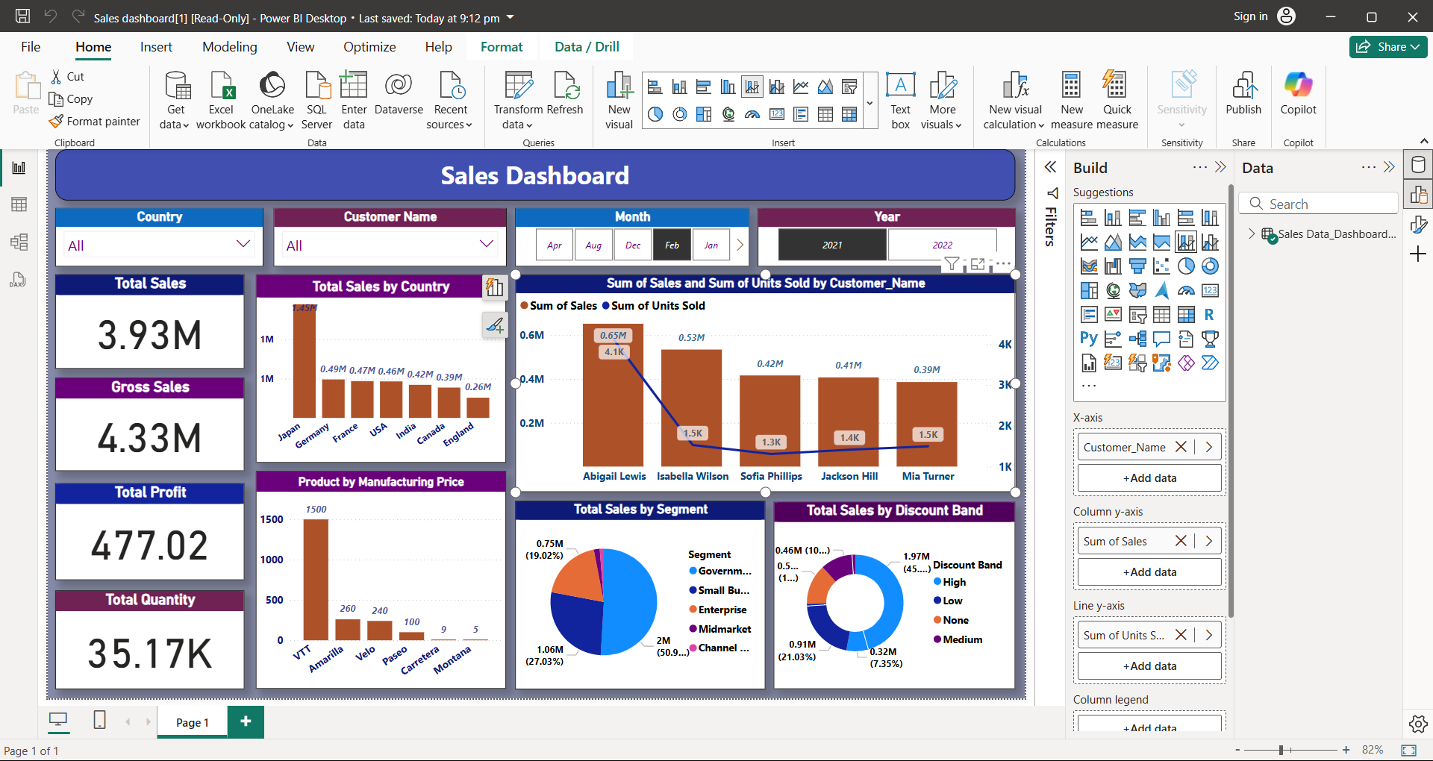
Your best quote that reflects your approach… “It’s one small step for man, one giant leap for mankind.”
- Neil Armstrong

Slide 3
Key Performance Indicators (KPIs)
Sales Summary – Overall Metrics
Total Sales: 3.93M
Gross Sales: 4.33M
Total Profit: 477.02
Total Quantity Sold: 35.17K

Slide 4
Sales by Country
Total Sales by Country Top Country: Japan – 1.45M Others:
Germany – 0.49M
France – 0.47M
USA – 0.46M
India – 0.42M
Canada – 0.39M
England – 0.26M

Slide 5
Sales by Customer
Top Performing Customers
Abigail Lewis: 0.65M (4.1K units)
Isabella Wilson: 0.53M (1.5K units)
Sofia Phillips: 0.42M (1.3K units)
Jackson Hill: 0.41M (1.4K units)
Mia Turner: 0.39M (1.5K units)

Slide 6
Product by Manufacturing Price
Product-wise Manufacturing Price
VTT: 1500
Amarilla: 260
Velo: 240
Paseo: 100
Carretera: 9
Montana: 5

Slide 7
Sales by Segment
Total Sales by Segment
Channel Partners: 2M (50.9%)
Enterprise: 1.06M (27.03%)
Midmarket: 0.91M (21.03%)
Government: 0.75M (19.02%)
Small Business: 0.5M (13%) (Note: Partially visible, assumed)

Slide 8
Sales by Discount Band
Total Sales by Discount Category
None: 1.97M (45.51%)
Medium: 0.91M (21.03%)
Low: 0.46M (10.59%)
High: 0.32M (7.35%)
Unknown: 0.5M approx (not fully visible, inferred)

Slide 9
Monthly & Yearly Filters
Data Filters Applied
Month: February
Year: 2021
Country: All
Customer Name: All

Slide 10
Summary & Insights
Key Takeaways
Japan leads in country-wise sales.
Abigail Lewis is the top customer.
VTT is the most expensive product by manufacturing cost.
Channel Partners contribute over 50% of total sales.
Majority of sales occur with no discount applied.

